Slide 1
HACK COVID-19 RESULTS
Team 6 – Wei, Hamid, Camille

Slide 2



WHO WE ARE
Camille Buschman
Wei Tang
Hamid Gadirov
BSc in Electrical Engineering Hanze University of applied Sciences
Msc in Singal and Information Processing; PhD in Medical Science, UMCG
MSc in Computer Science University of Stuttgart; PhD in Computer Science, Bernoulli Institute, RUG

Slide 3
GOALS
Analyse
Compare
Prevent
Analyse and find correlations between variables
Compare data from different countries with each other
Predict and prevent future pandemics

Slide 4
TABLE OF CONTENTS
01
02
GOALS
RESULTS ANALYSIS
03
04
REGRESSION
CONCLUSIONS
The aim and goals we want to achieve
Patterns, solutions and problems
What we did with the results of the analysis
How can we prevent, manage, leave a pandemic

Slide 5
QUESTIONS
Does government response affect daily new cases?
Does new vaccinations affect the number of daily cases and daily deaths?
Is it possible to use machine learning models for regression and report the importance of variables?
Can a machine learning model be used to forecast the convergence of COVID-19 in the future?
Mallapaty S. The coronavirus is most deadly if you are older and male-new data reveal the risks[J]. Nature, 2020: 16-17.

Slide 6
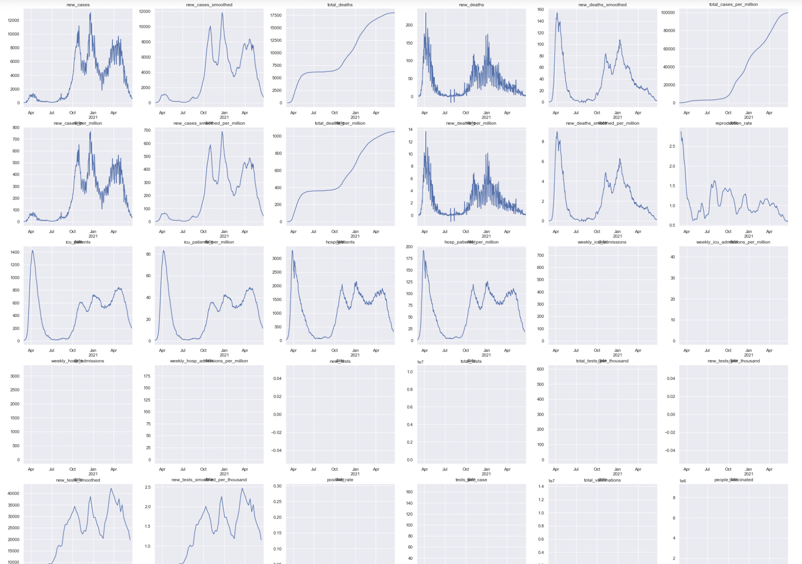
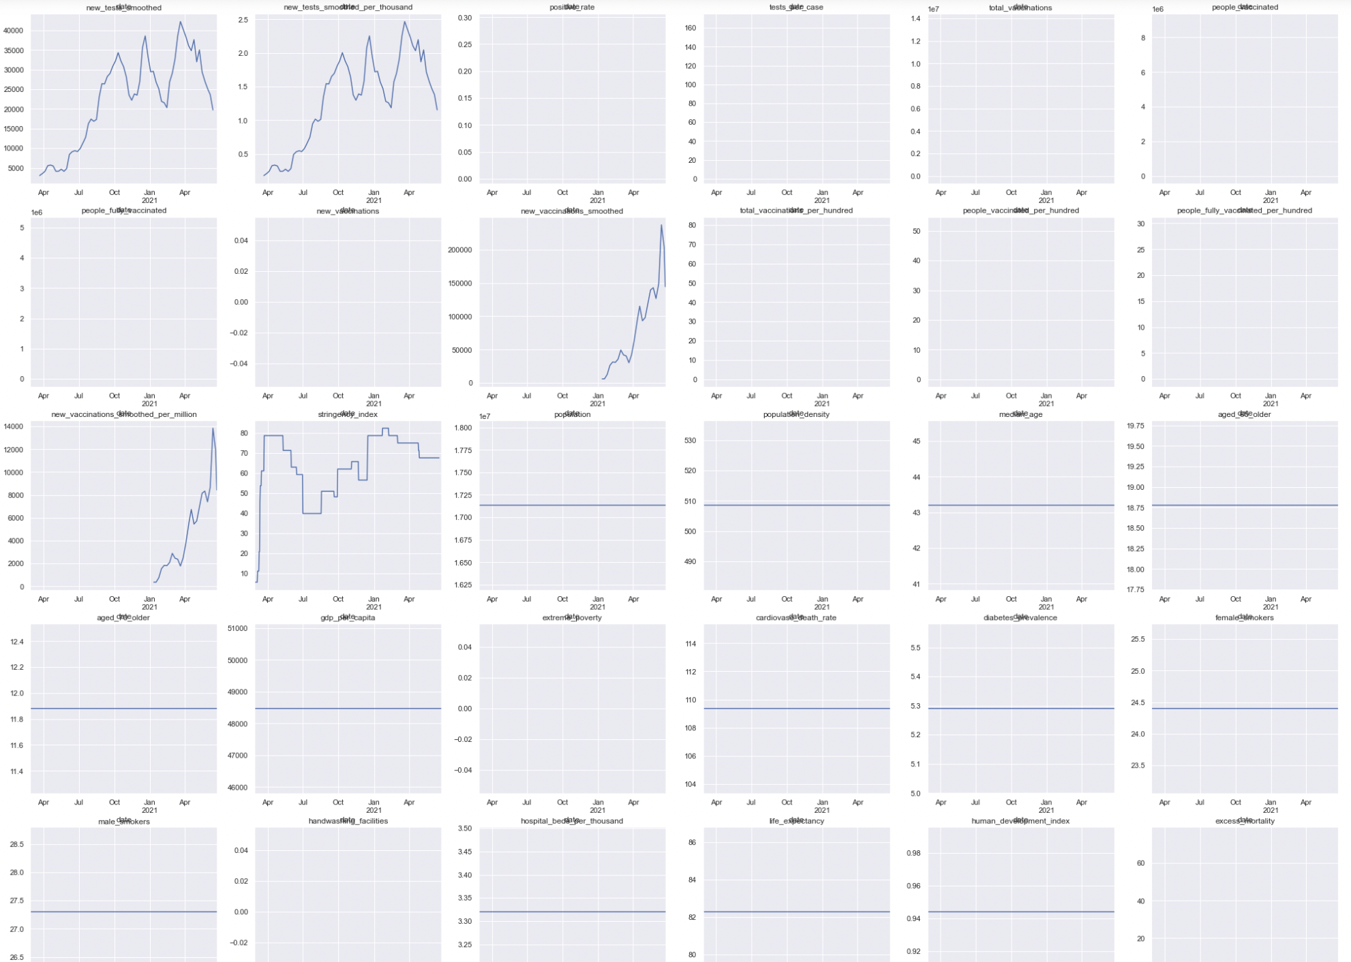
RESULTS ANALYSIS
Reproduction rate, ICU-patients, Hospital-patients, New tests smoothed, Stringency Index, New vaccinations smoothed, New cases, New Deaths
Notes:
- Many are constants, NAN
Many variables are the samthing: new cases, new cases smoothed…
After drop these, we only need to analyze the impact of reproduction_rate, icu_patients, hosp_patients, new_tests_smoothed,
stringency_index , new_vaccinations_smoothed to new_cases and new_deaths for the Netherlands.

Slide 7
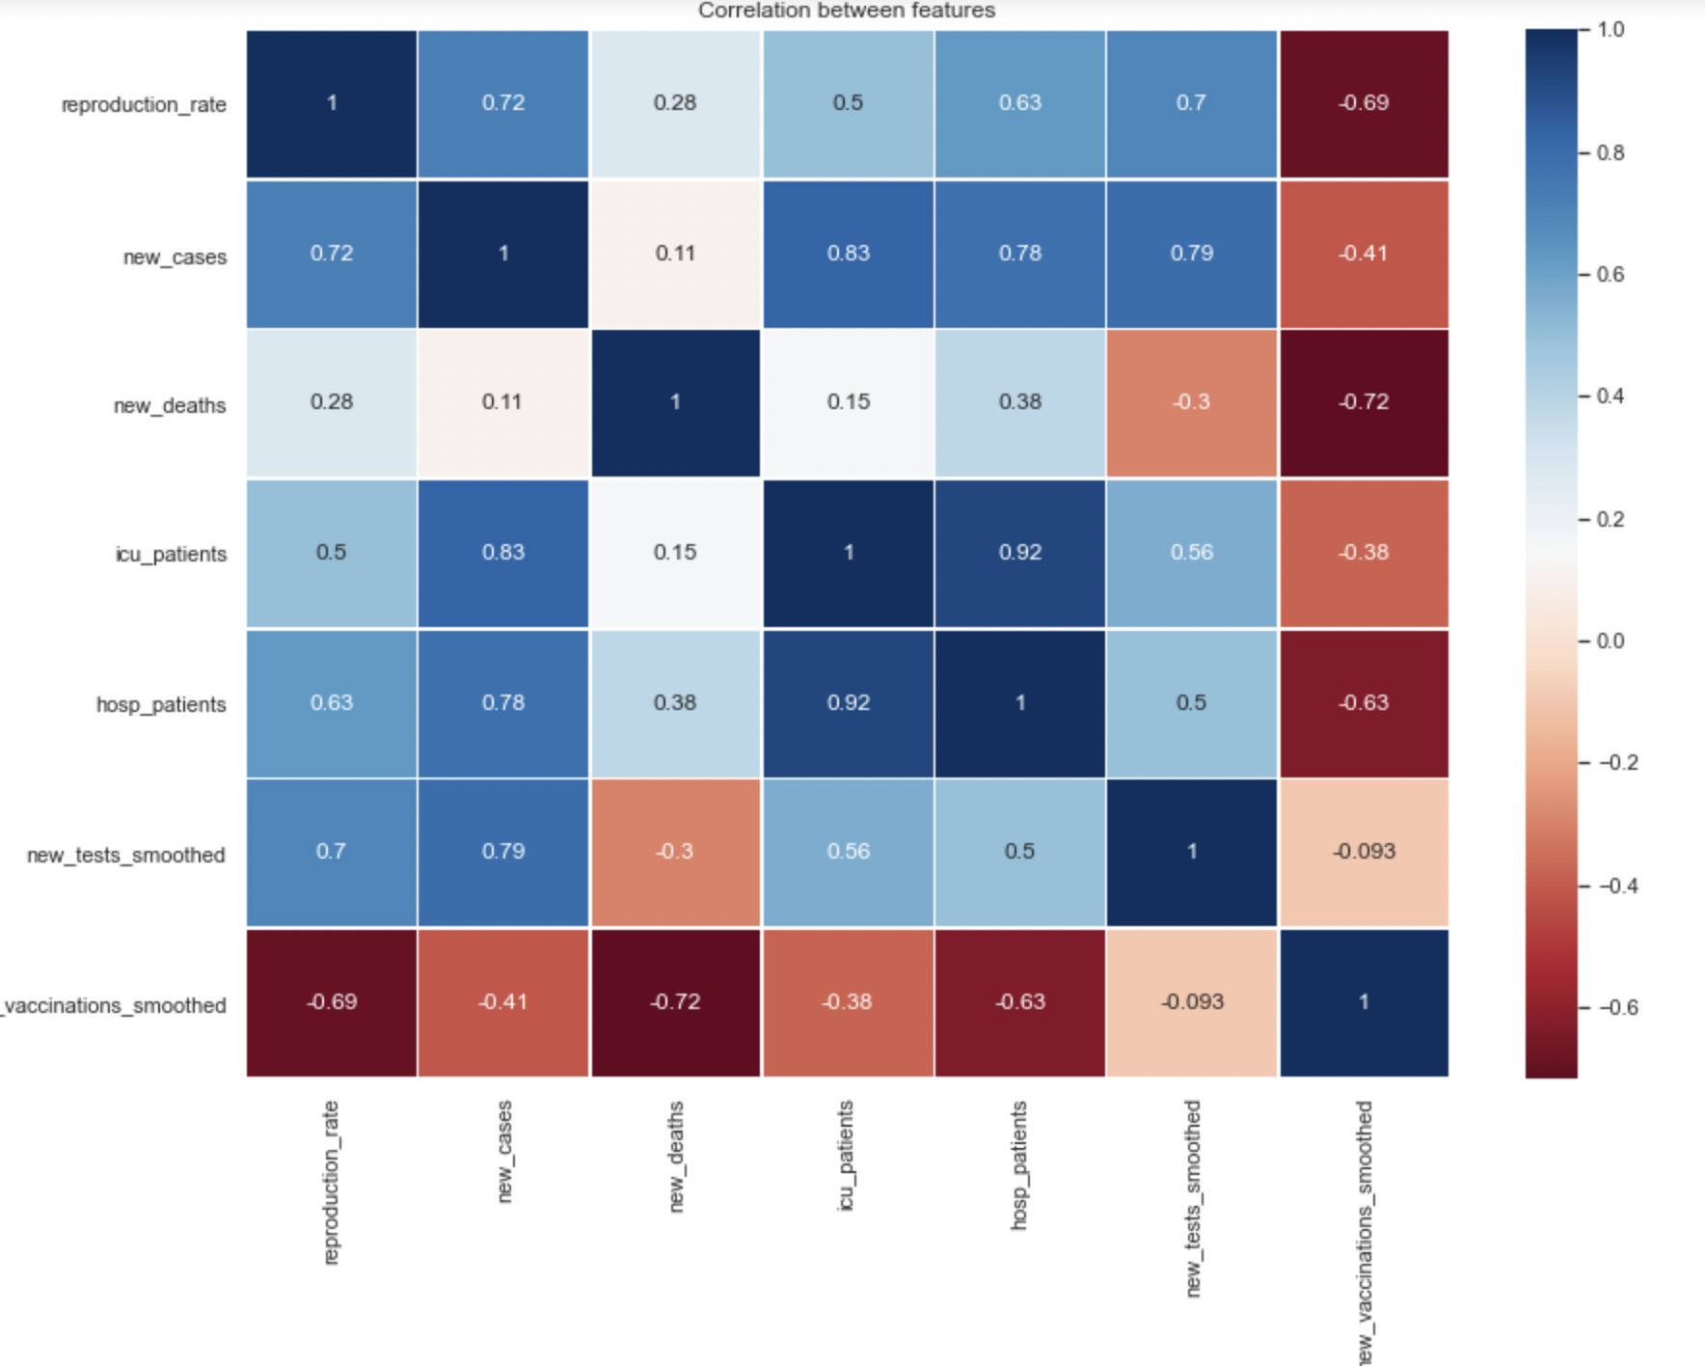
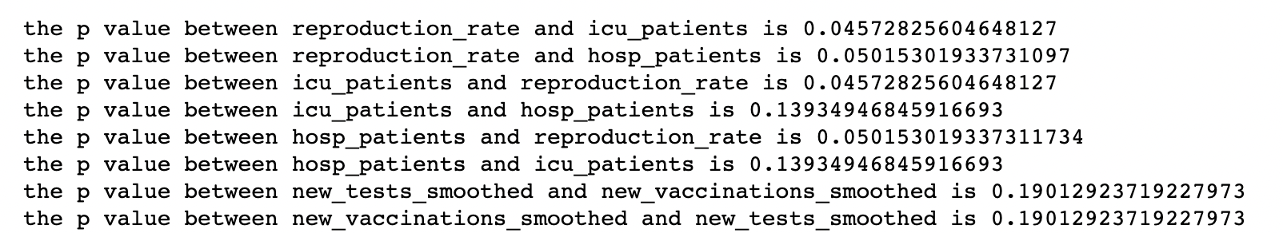

RESULTS ANALYSIS
Variables correlation using data after 2021-01
CHI SQUARE TEST RESULTS
Notes:
- New vaccinations and new deaths highly negative correlated
- New vaccinations and hospital patients highly negative correlated

Slide 8
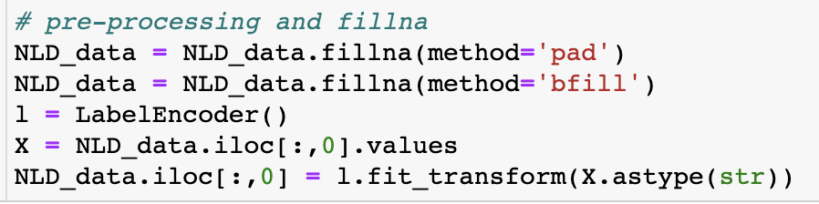
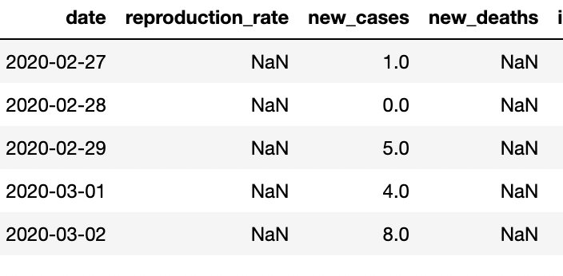
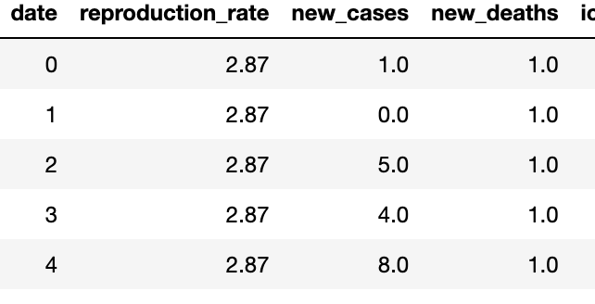
REGRESSION

Slide 9
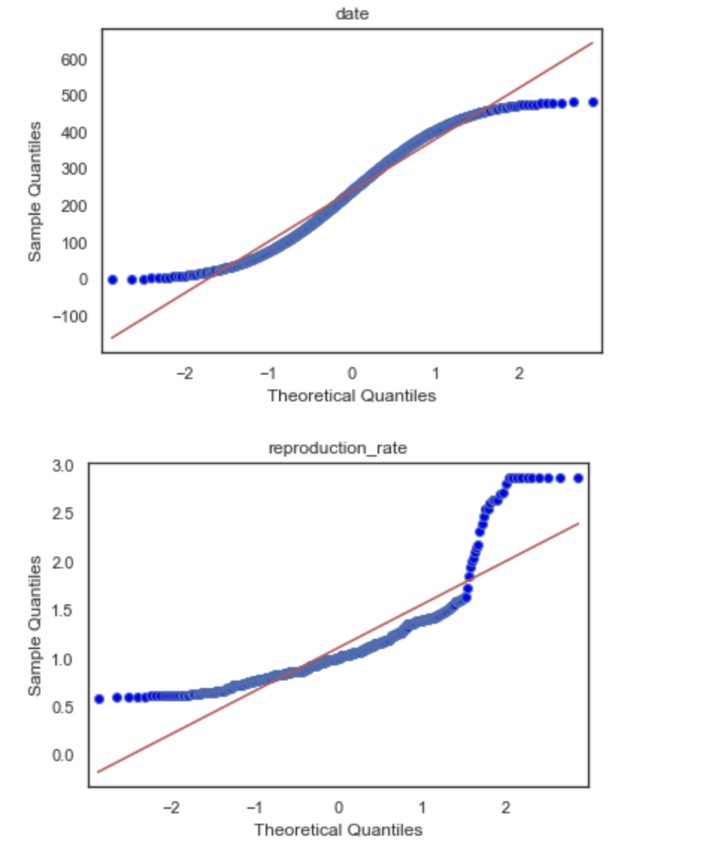
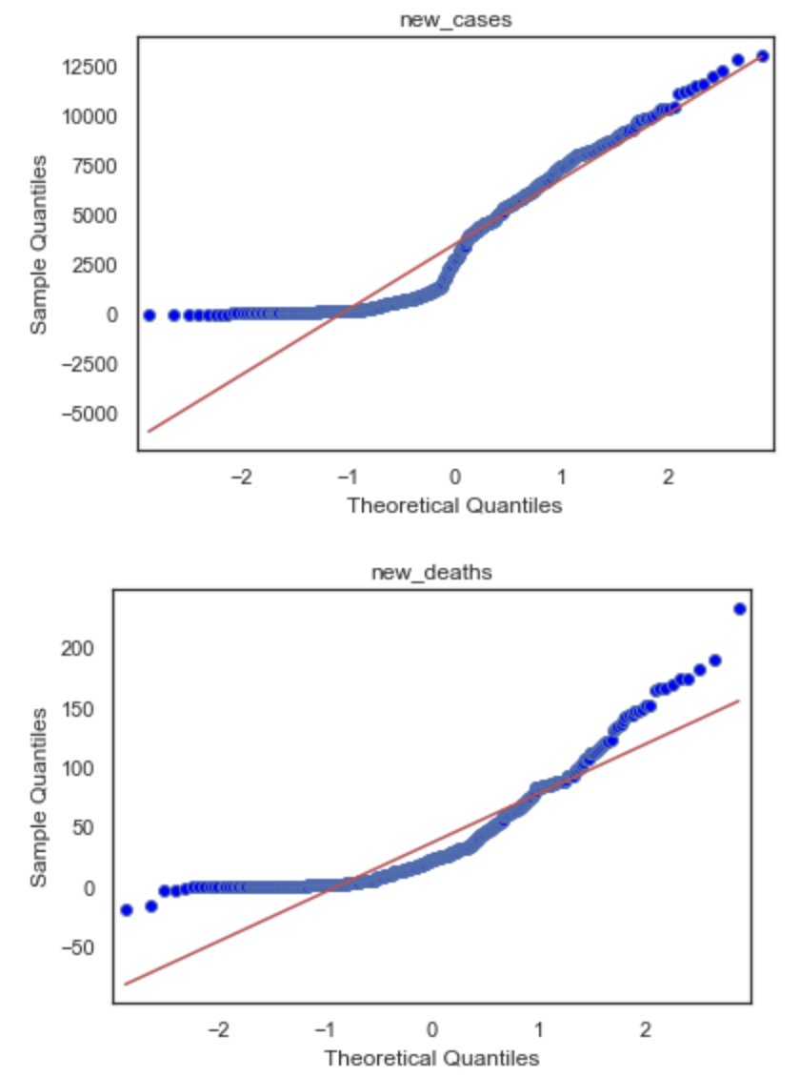
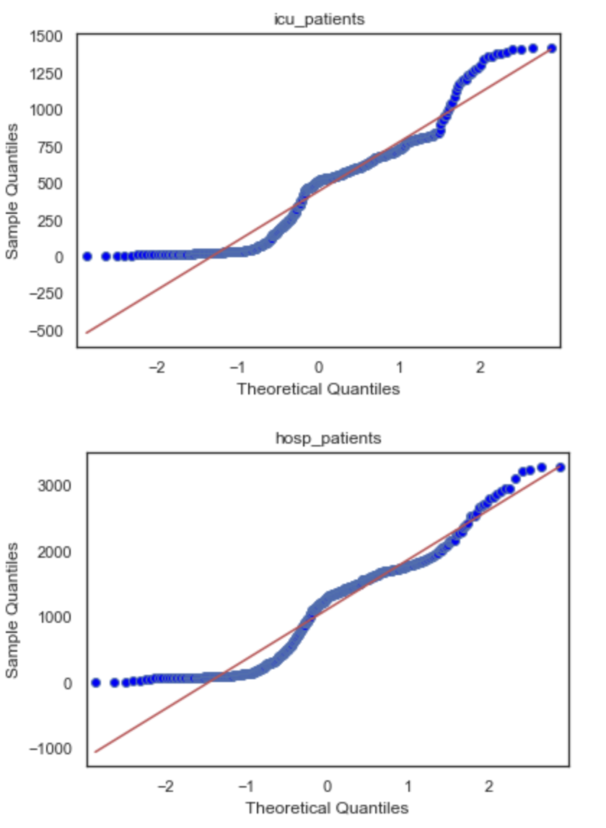
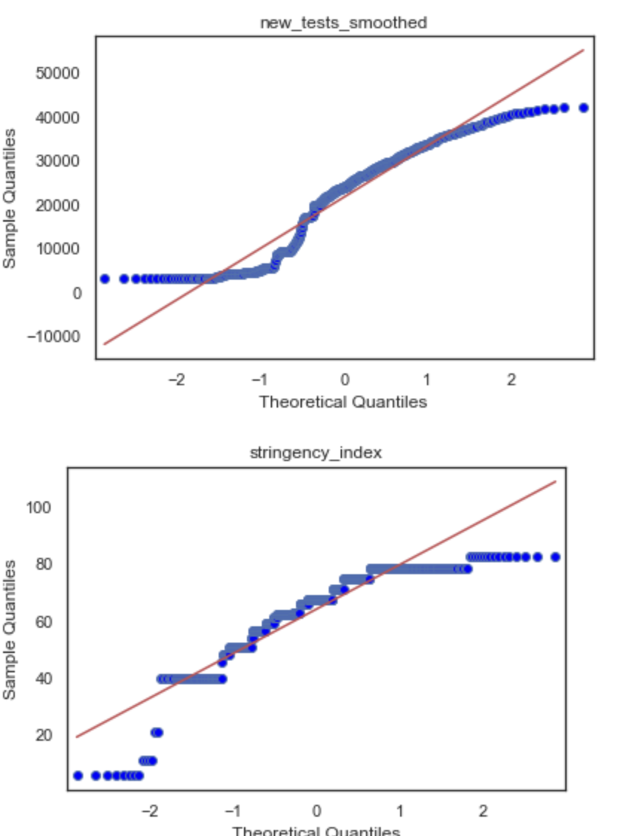
REGRESSION
Notes:
Checking normal distribution
We can see that the variables are normally distributed

Slide 10
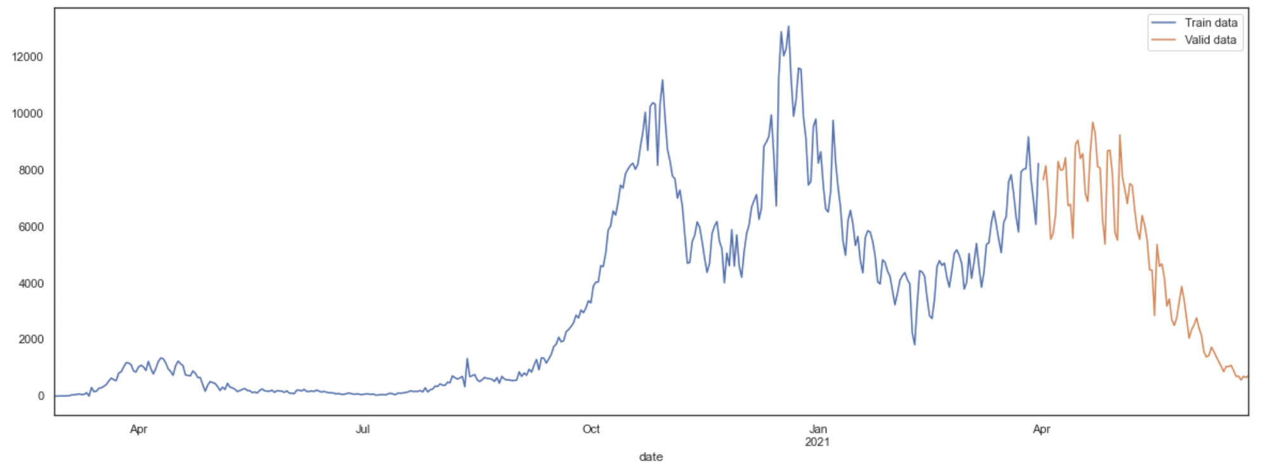
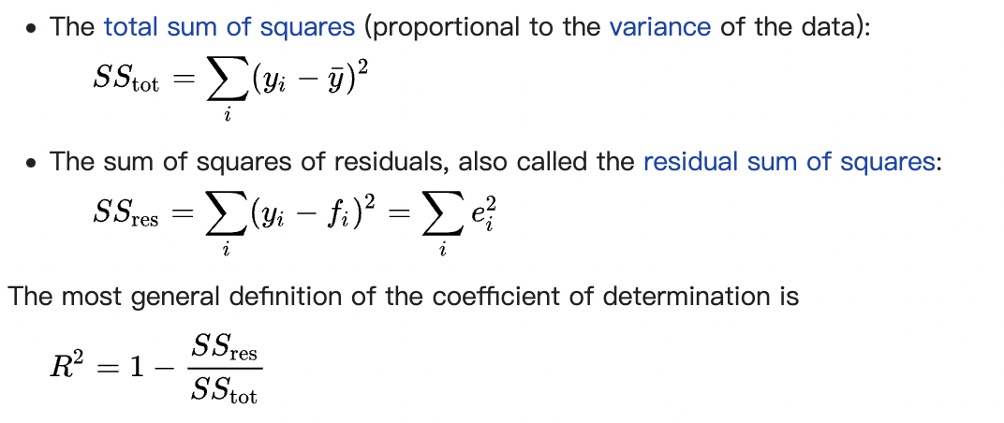
REGRESSION
Split data
Training: data before April 2021
Validation: data after April 2021
Models
Multi-linear Regression
Random Forest
Support Vector Regression
Metrics
Coefficient of determination (R-square)

Slide 11
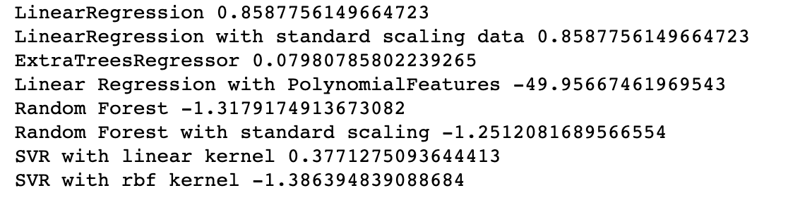
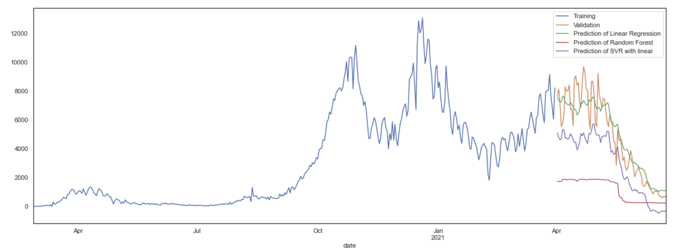
PREDICTION OF NEW CASES
Notes:
Linear regression had the best result (Green line)

Slide 12
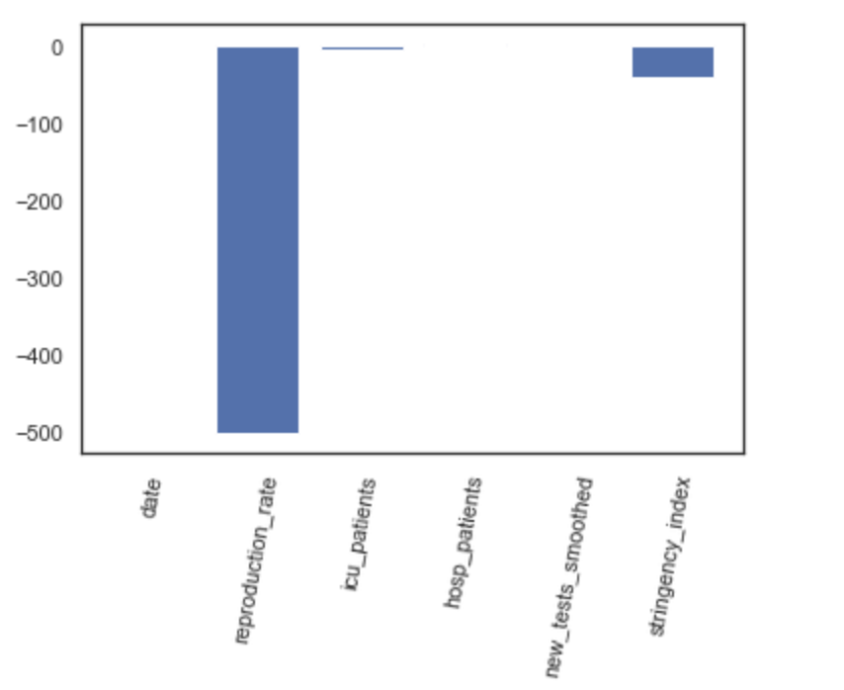
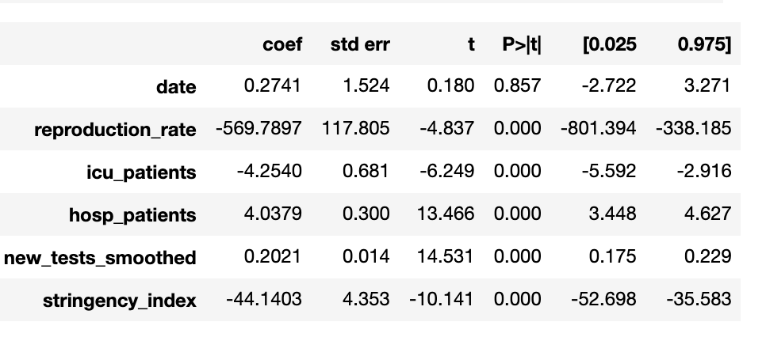
MULTI-LINEAR REGRESSION MODEL EXPLAINED
A significant regression equation F(6,394)= 643, p<0.0001.
Reproduction_rate, icu_patients, hosp_patients,
New_tests_smoothed, stringency_index(t=-10.141,p<0.0001)
Notes:
F-Test and T-test to find the most significant variables
Reproduction_rate, icu_patients, hosp_patients, have significant effect of daily new cases

Slide 13
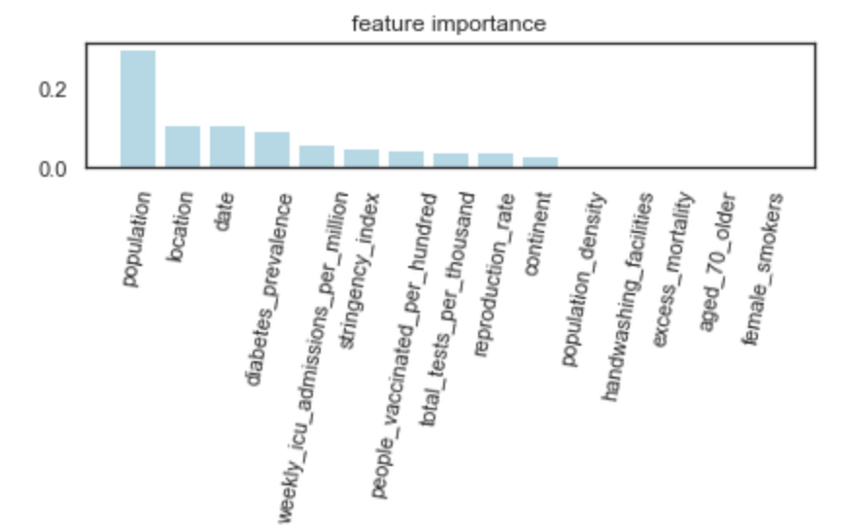
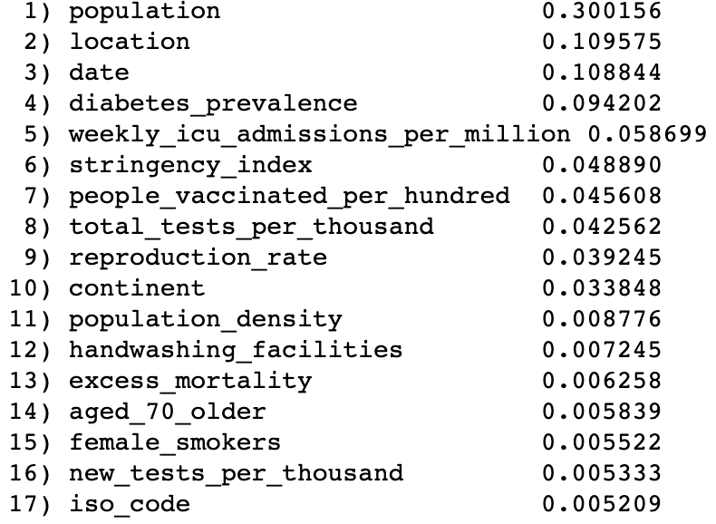
PREDICTION FOR THE WHOLE DATASET
Random Forest Results -Daily new cases
Notes:
For all countries in the OWID dataset
Trained the models with the whole dataset and the best trained model was the Random Forest model, with an R-value of 0.99
The most important features to predict new cases are population location and date

Slide 14
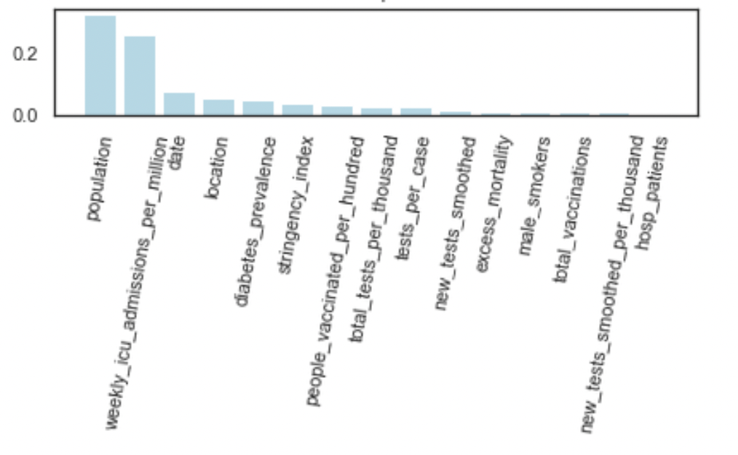
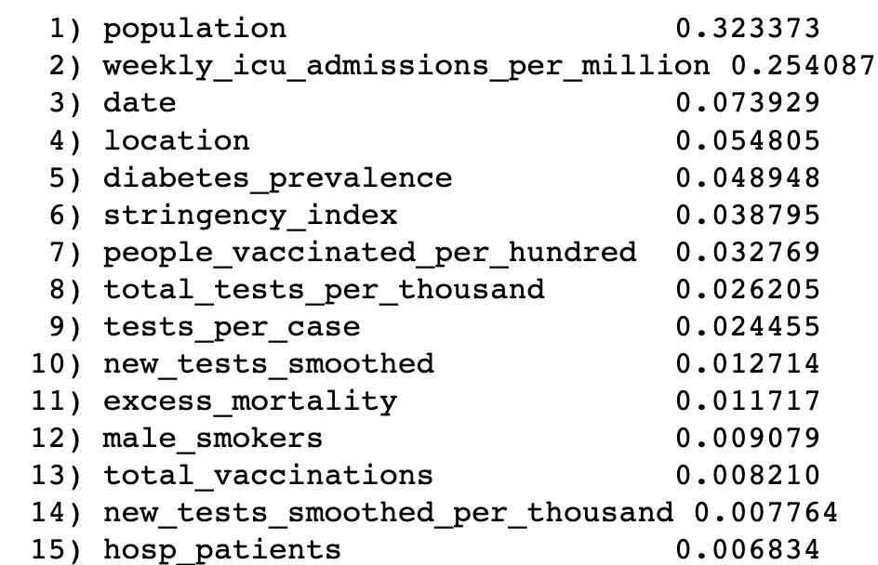
PREDICTION FOR THE WHOLE DATASET
Random Forest Results -Daily new deaths
Notes:
For all countries in the OWID dataset
Trained the models with the whole dataset and the best trained model was the Random Forest model, with an R-value of 0.99
The most important features to predict new cases are population location and date

Slide 15
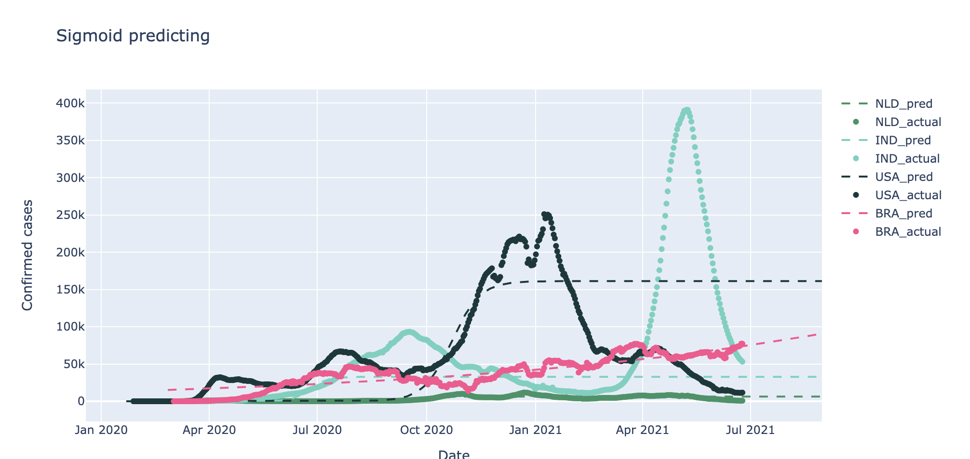
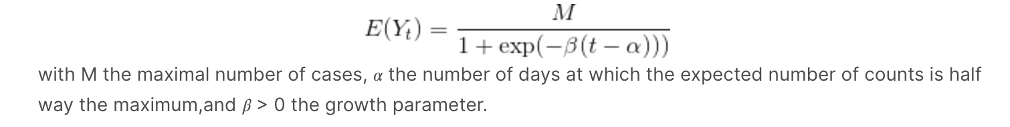
FORECASTING
Dutra C M. Non-Linear fitting of Sigmoidal Growth Curves to predict a maximum limit to the total number of COVID-19 cases in the United States[J]. medRxiv, 2020.
Notes:
Forecasting confirmed cases
Very difficult because this model is only based on the confirmed cases previously. So not accurate of the whole situation. There are also other unknown variables that have influence on the new cases.
Only accurate for brazil

Slide 16
CONCLUSION
Does government response affect new/deaths cases?
“The stringency index has significant effect on predicting the new/deaths cases”
Does new vaccinations affect the number of new/deaths cases?
“There is a negative correlation between new vaccinations and new/deaths cases”
Is it possible to use machine learning models for regression and report the importance of variables?
“The random forest result showed that the most important variables are population, date, location and weekly ICU patients to predict new/deaths cases”
Can a model be used to forecast the convergence of COVID-19 in the future?
“It is difficult to use a model for forecasting because there are a lot of unknown variables”

Slide 17
RESEARCH RESOURCES
Our World in Data dataset, OWID
Oxford COVID-19 Government Response Tracker dataset
Scikit-learn: Machine Learning in Python, Pedregosa et al., JMLR 12, pp. 2825-2830, 2011.
Raj, A.R. (2020, 3 Oct). Unlocking the True Power of Support Vector Regression. Towards data science.
Dutra C M. Non-Linear fitting of Sigmoidal Growth Curves to predict a maximum limit to the total number of COVID-19 cases in the United States[J]. medRxiv, 2020.

Slide 18
Questions?

